Slide 1
Designing Crowdfunding DashBoard
05/15/2023
Mako B, Rob C, Amit S, and Woyni T

Slide 2
Pros Cons
01
Restricted from performing quick analysis unlike Excel
Ability to have multiple independent tables
New tables can be added efficiently
Maintains relationships among tables
02
Security and Efficiency
Dataset not big enough to realize efficient gains
03
Data Driven Application
Excel does not feed directly into Dashboard
Less accessible than Excel. Codes are required to interact with relational databases.

Slide 3
Tableau
Tableau interface not compatible with Google Slides.

Slide 4

Choose Key performance Indicators
KPIs should be less than 10 and include items important to stakeholders.
Conversion Rate : # of successful campaigns/ # Total campaigns
Average Pledge
No. of Backers
Target Amount/Pledged Amount ratio – Make tranches of 0 to 500, 500 to 2000, 2000 to 5000, 5000 to 10,000 and >10,000
Geographical Area – Top 5 countries and bottom 5 countries by total amount.
Ratio of “Pledged” / “Goal”.

Slide 5

SMART Goals and Benchmark
SMART: Specific, Measurable, Achievable, Relevant, and Time-bound Goals
“I want to raise $10,000 in 30 days”
Base goals and Benchmark for KPIs using historical data

Slide 6
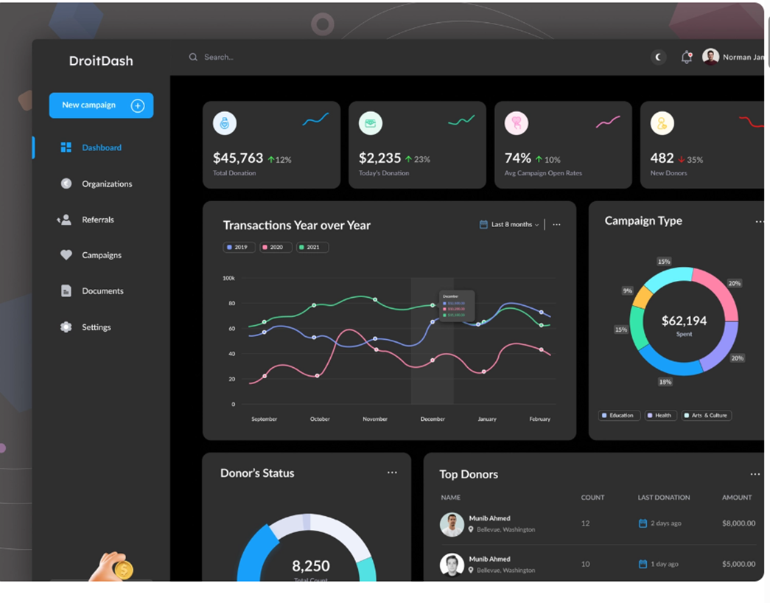
DashBoard Example

Slide 7
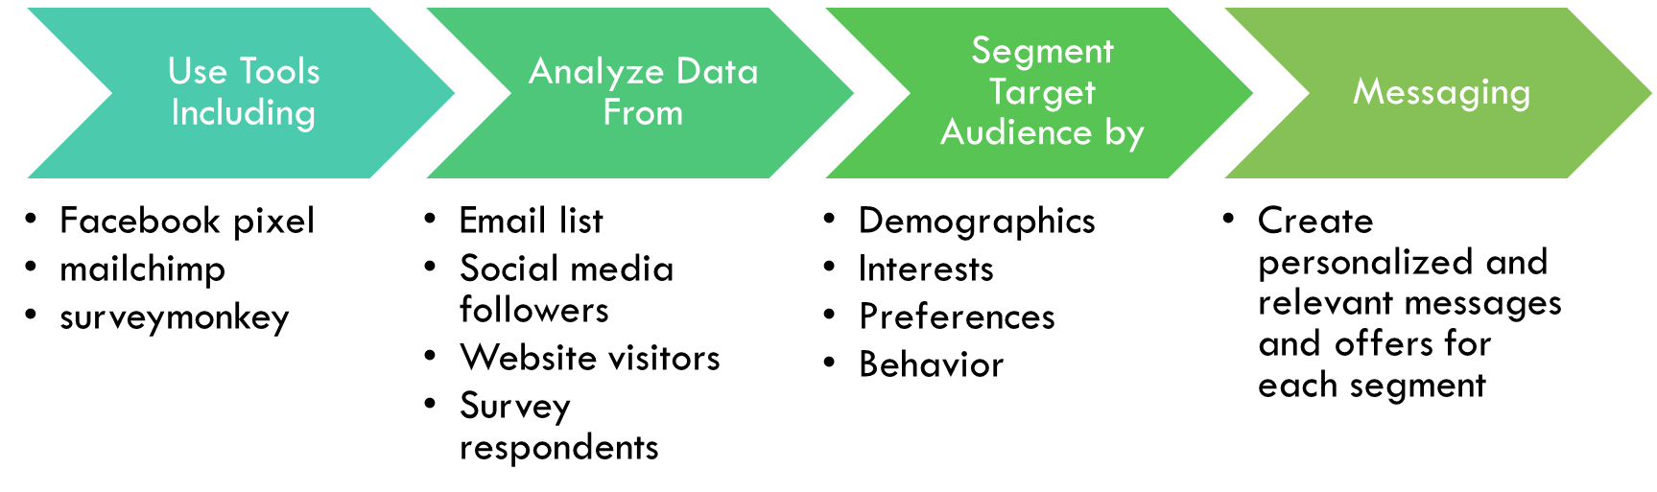
Segmentation and Messaging

Slide 8
Conclusion
Important to consider the tasks that go beyond default reports including frequency. This can indicate which platform is best suited for real-time adjustments.
Align Data Needs
Focus on Data Literacy
Review Decisions
Notes:
https://www.cmswire.com/digital-marketing/excel-sql-python-whats-your-data-flavor-for-customer-experience/

